Slide 1

Discount Duckies
An intro to bad usbs

Slide 2
contents
What is a Rubber Ducky?
What can a Rubber Ducky do?
Intro to DuckyScript
Our “discount ducky”
Try it out!
Notes:
So here is what we’re going to cover over this session – first we have “what is a rubber ducky?”. Then we have well ok we know what a ducky is, what does it do? Once we know what it does we’re going to go ok well how do we make it do what it does, and that’s where ducky script comes in. Once we’ve seen a little bit of ducky script we’re thinking right, this is cool, I already know what nefarious things I’m going to do with this, I’m gonna go and buy one so you’ll go onto the Hak5 website and go WOAH, that’s really expensive if only I could make one for cheaper – and that’s where our “discount ducky” comes in – I’m going to show you how to make a very cheap digispark board into a rubber ducky bad usb. Once we’ve done all that, it’ll be over to you guys to make your own! Everybody happy? Good!

Slide 3

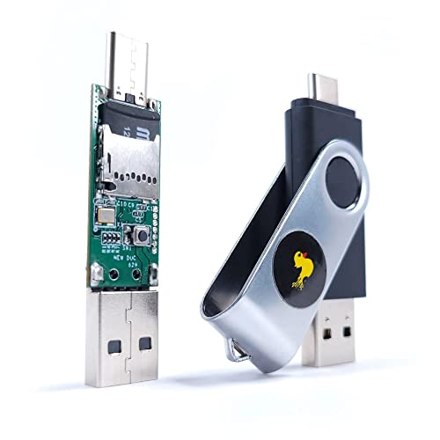
Rubber Ducky
badUSB
Hak5
*quack*
Notes:
Ok a rubber ducky – what is it? Yes, it’s a friend who can prevent loneliness in the bath, but this particular kind of ducky isn’t really much company. No, this kind of rubber ducky is what we call a bad usb. Anyone know what a bad usb is? Ok, a badusb is a device that mimics a keyboard and takes the shape of a USB stick. The idea is, your victim plugs in the device, and it performs a bunch of actions on a victim’s computer through the keyboard. For example, you can make it open the command prompt or powershell and type in a script, or even something like windows defender, yes it can be a very dangerous thing. But of course here we aren’t stupid enough to plug in a random USB that we don’t know what it is.
Now on the screen you can see “hak5” oh well what’s hak5? Anyone know? Hak5 is a retailer of hacking tools like a rubber ducky, a flipper zero, OMG cables, anyone bought anything from hak 5?
On the screen there, that’s a rubber ducky from hak 5. A rubbery ducky is the most marketed version of a bad usb, but there are others. Why is it called a rubber ducky, I have no idea. Now let’s move on to what does a rubber ducky actually do?

Slide 4
What do?
Keyboard
Reverse shell
The Laptop Cooker
Information Stealer
Notes:
Well, yeah we’ve said it asks as a keyboard. Typically, bad USBS are used for bad purposes – the creator can literally make your computer do whatever they want as long as it can be done with keystrokes. We will show you some demos in just a minute of the following. We could make a reverse shell, where you can gain full and complete access to a victim’s computer remotely. Adam is going to demo an information stealer, and then one that we just call “the laptop cooker” and you’ll see why soon, so you can really do anything with this. You plug it in, and it does your bidding. Now, before we do anything else, can you all please get yourselves into groups of <number>. You will all be working in groups for this.

Slide 5
How do?
Download Arduino IDE from: https://www.arduino.cc/en/software
Notes:
Before we get into anything else, I am going to go over what we need to know in order to make our discount ducky. We will need two things. 1) A digispark board – check. 2) Arduino software – check. In addition to the two things we need, we also need to know something – something called C++. Does anyone here know any C++? If you don’t, not to worry as we don’t need to know too much about it, and when you start your classes you’ll learn C++ there as well. Now, let’s get started – there is a small amount of setup that we will do together. If one person in each group could please log on to a computer and install the software from the link on the screen that would be great.

Slide 6
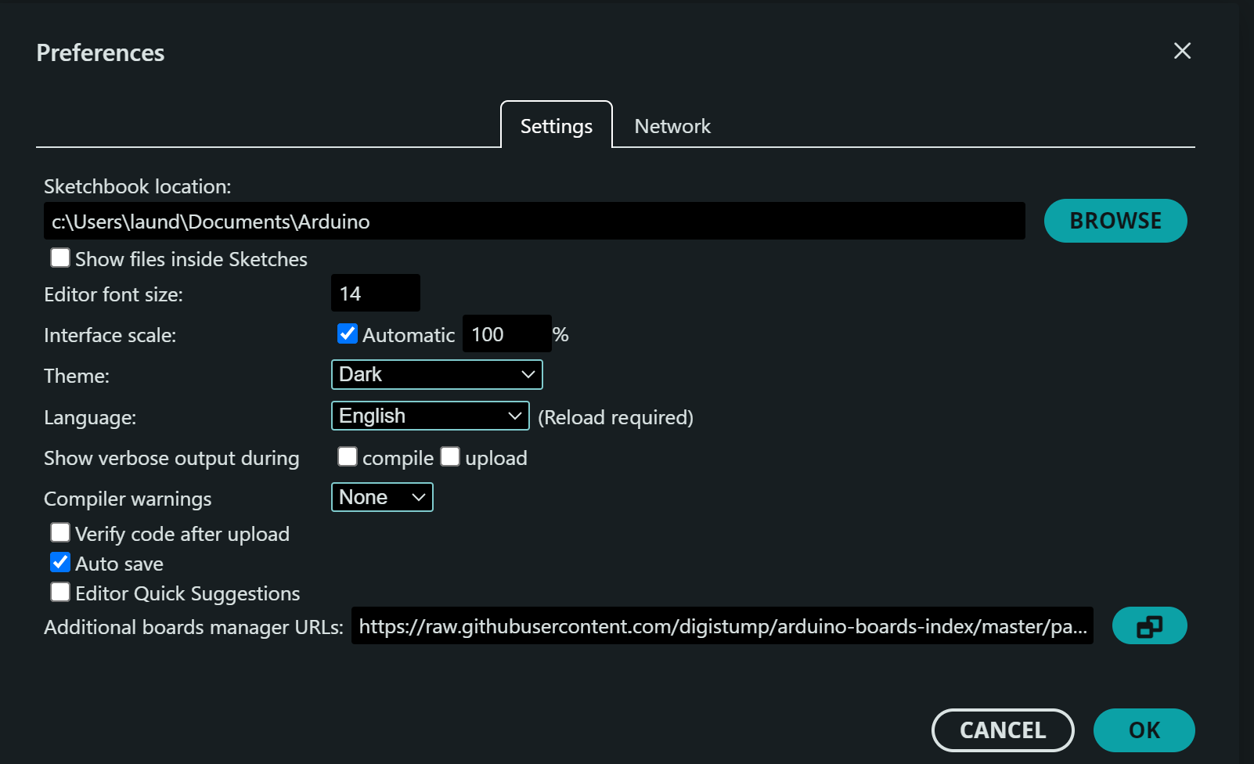
URL: https://raw.githubusercontent.com/digistump/arduino-boards-index/master/package_digistump_index.json
Notes:
Once you’ve downloaded the software, we will need to add support to the board. We need to go to file > preferences, and in the “additional boards manager URLs” box and add the link on the screen. Can you all please do this.

Slide 7
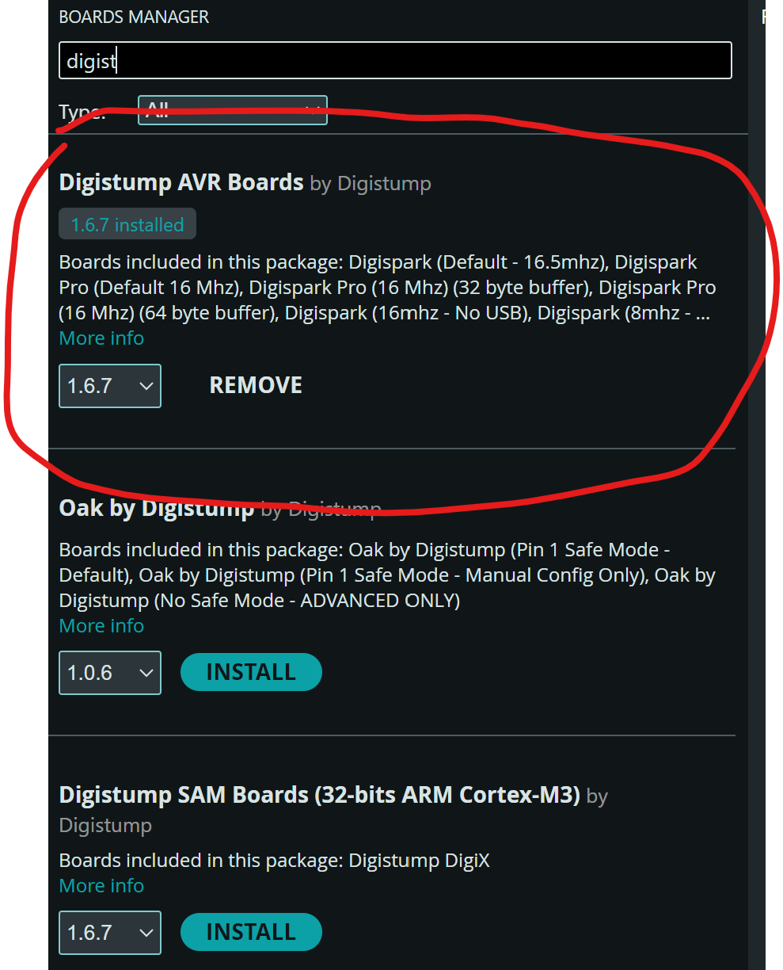
Tools > board > board manager
Notes:
Once we have added the URL, we need to add the board. In the Arduino software, go to tools > board > board manager and search for digistump. Install the Digistump AVR Boards option.

Slide 8
(almost) Final Set up
Download Link:
https ://github.com/digistump/DigistumpArduino/releases/download/1.6.7/Digistump.Drivers.zip
Notes:
Ok folks, almost there I promise. Go to this link to download the zip file.

Slide 9
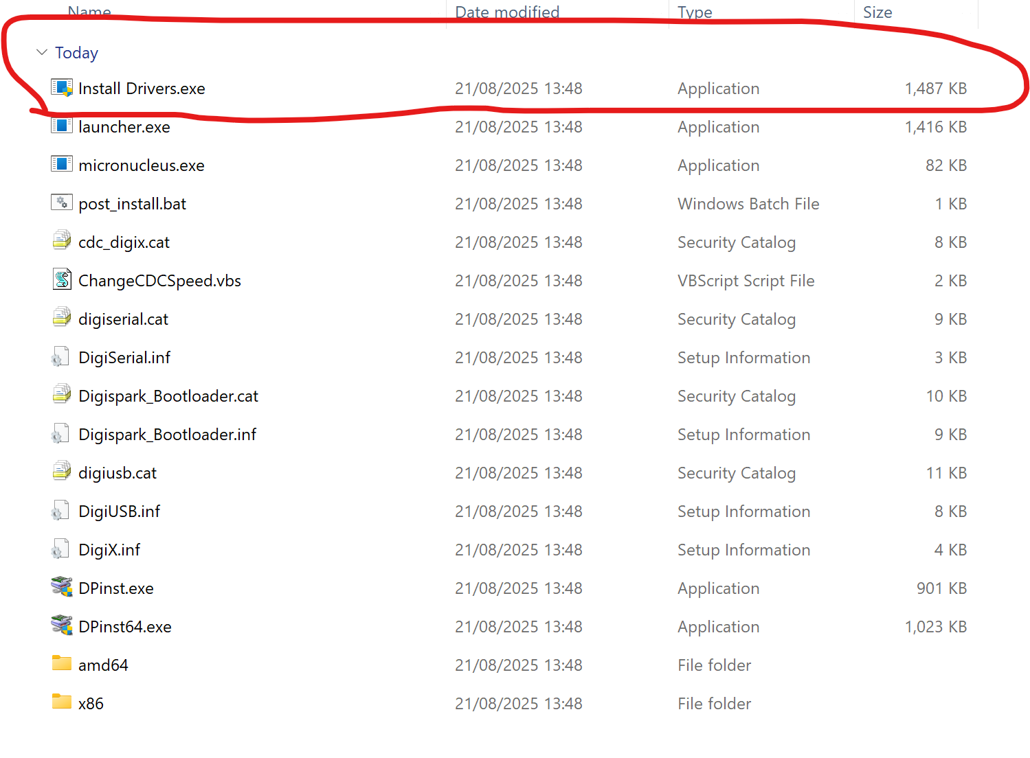
Drivers
Notes:
Once you’ve downloaded the zip file, extract it and run the “install drivers.exe” file.

Slide 10
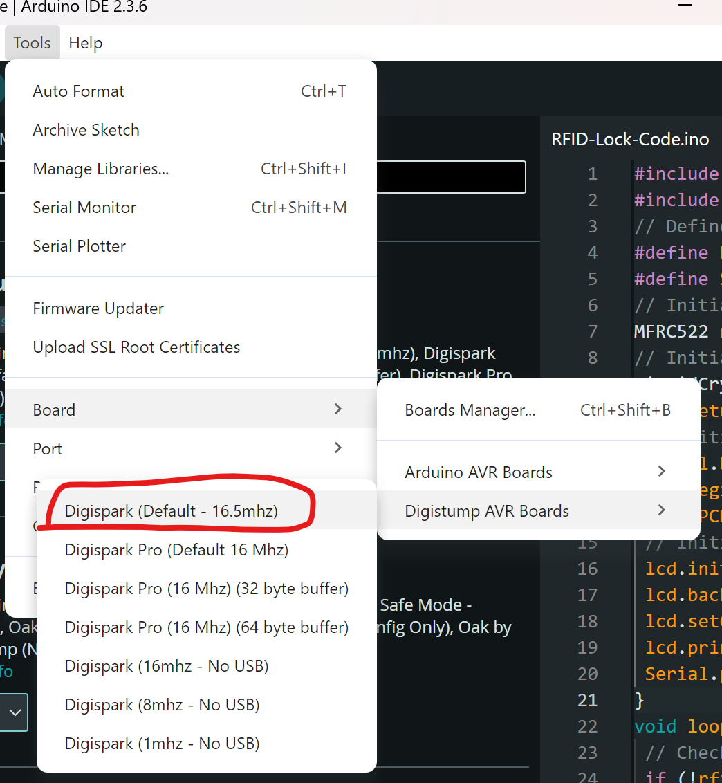
Tools -> Board -> Digistump AVR Boards -> Digispark Default 16.5 mhz
Notes:
Finally, last bit of set up, go to Tools -> Board -> Digistump AVR Boards -> Digispark Default 16.5 mhz

Slide 11

Programming

Slide 12
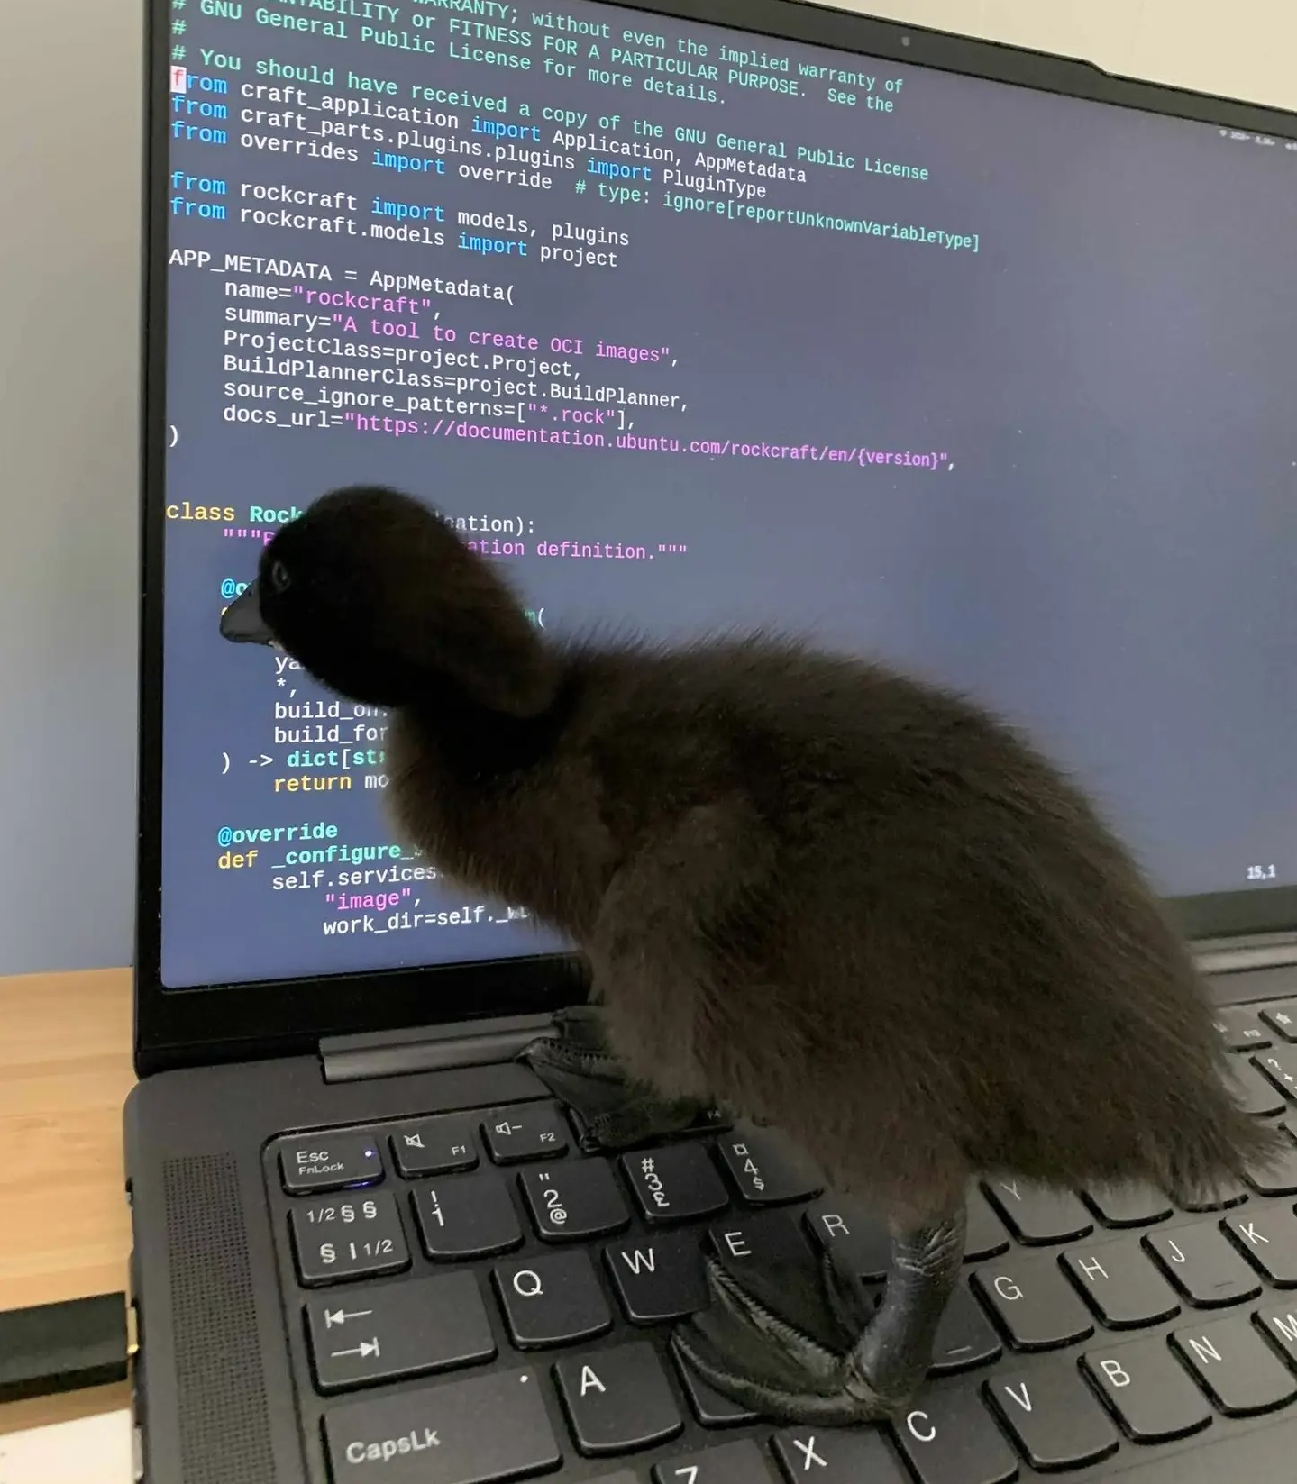
Ducky Script!
First available around 2010
Designed to be simple and easy to understand
Available on a limited amount of devices
Quack

Slide 13
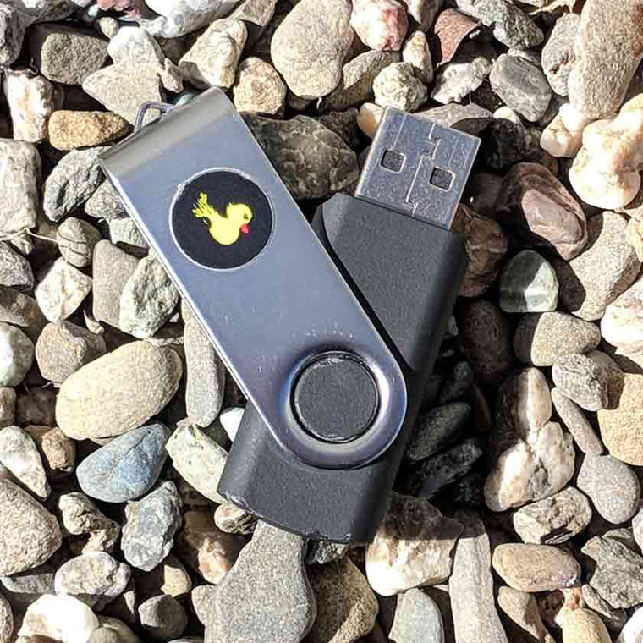
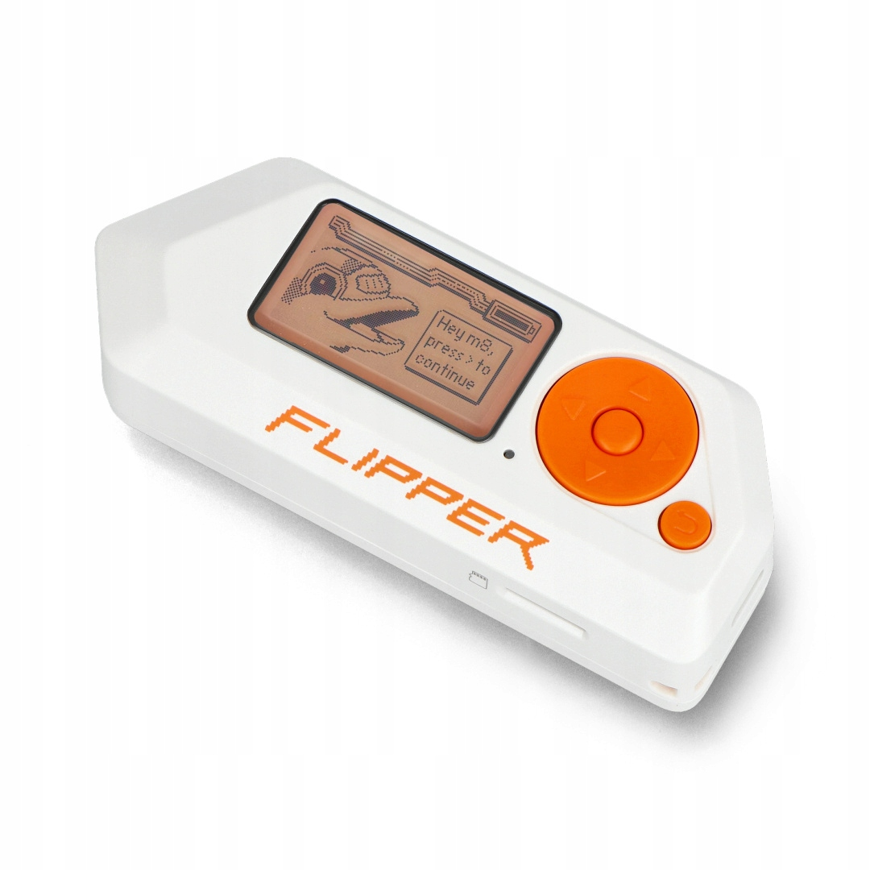
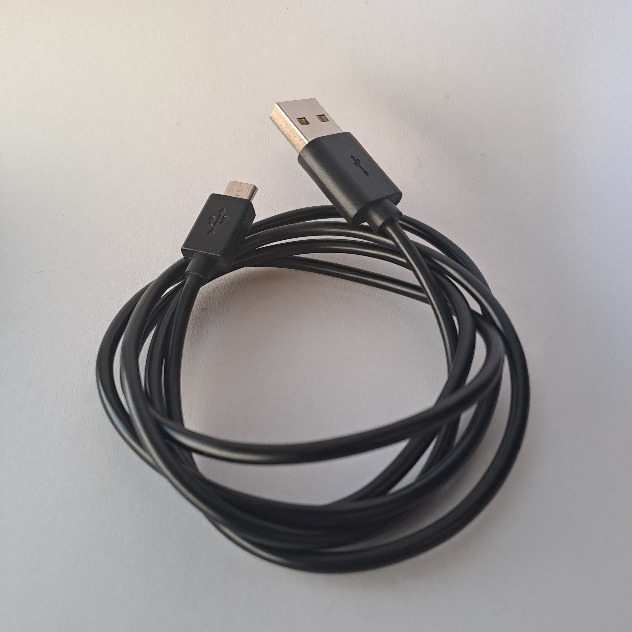
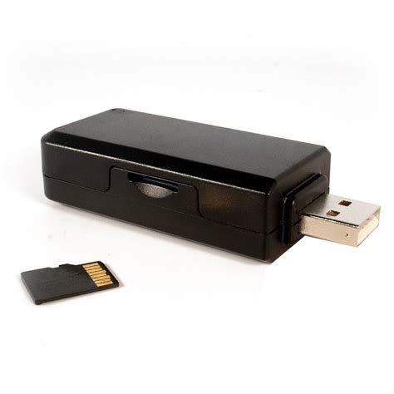
Why not ducky script?
£129.95
£189.00
£229.00
£299.00

Slide 14

The solution?

Slide 15
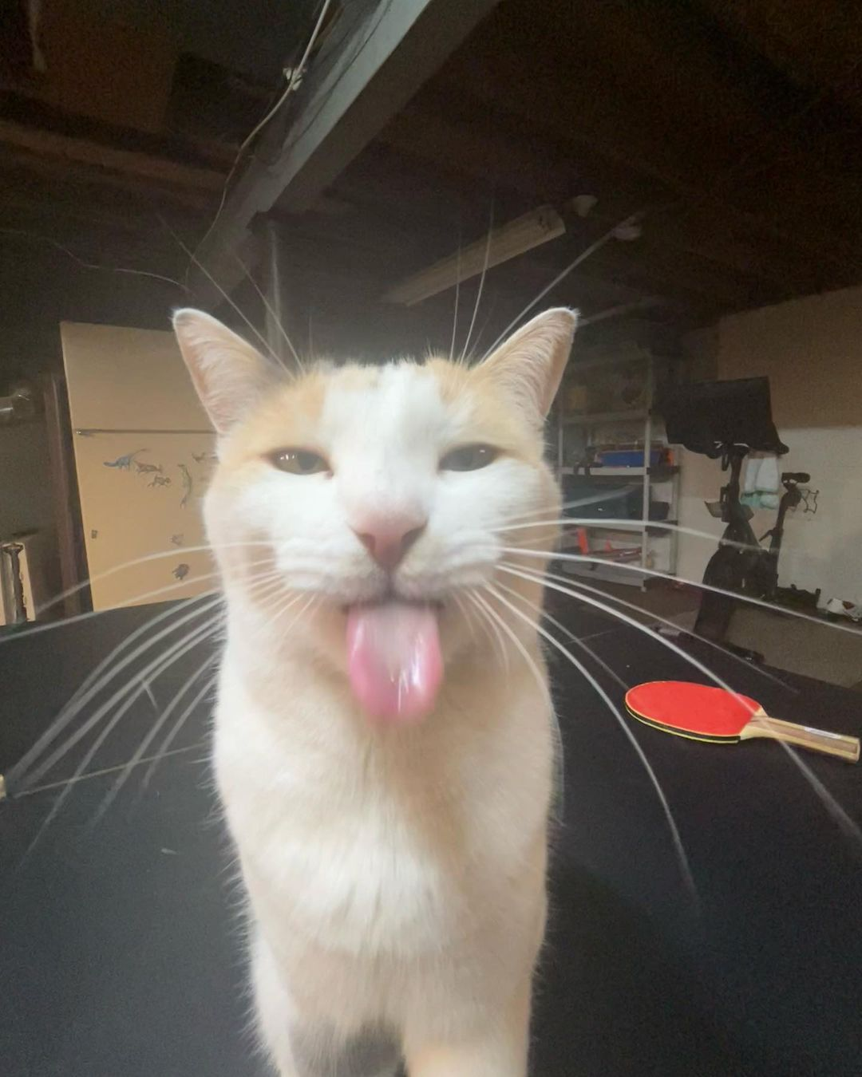
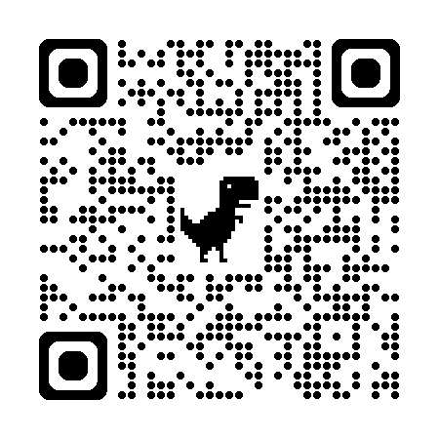
i mean you can if you want
https://cedarctic.github.io/digiQuack/

Slide 16
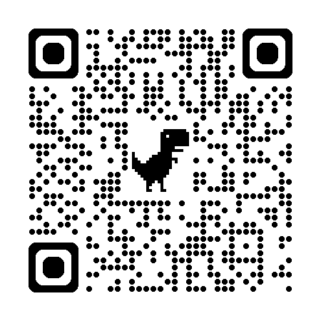
How to bad usb
#define KEY_NOKEY 0x00 // Reserved (no event indicated)
#define KEY_ERR_ROLLOVER 0x01 // Keyboard ErrorRollOver
#define KEY_POSTFAIL 0x02 // Keyboard POSTFail
#define KEY_ERR_UNDEFINED 0x03 // Keyboard ErrorUndefined
#define KEY_A 0x04 // Keyboard a and A
#define KEY_B 0x05 // Keyboard b and B
#define KEY_C 0x06 // Keyboard c and C
#define KEY_D 0x07 // Keyboard d and D
#define KEY_E 0x08 // Keyboard e and E
#define KEY_F 0x09 // Keyboard f and F
#define KEY_G 0x0A // Keyboard g and G
#define KEY_H 0x0B // Keyboard h and H
#define KEY_I 0x0C // Keyboard i and I
#define KEY_J 0x0D // Keyboard j and J
#define KEY_K 0x0E // Keyboard k and K
#define KEY_L 0x0F // Keyboard l and L
#define KEY_M 0x10 // Keyboard m and M
#define KEY_N 0x11 // Keyboard n and N
#define KEY_O 0x12 // Keyboard o and O
#define KEY_P 0x13 // Keyboard p and P
#define KEY_Q 0x14 // Keyboard q and Q
#define KEY_R 0x15 // Keyboard r and R
#define KEY_S 0x16 // Keyboard s and S
#define KEY_T 0x17 // Keyboard t and T
#define KEY_U 0x18 // Keyboard u and U
#define KEY_V 0x19 // Keyboard v and V
#define KEY_W 0x1A // Keyboard w and W
#define KEY_X 0x1B // Keyboard x and X
#define KEY_Y 0x1C // Keyboard y and Y
#define KEY_Z 0x1D // Keyboard z and Z
#define KEY_1 0x1E // Keyboard 1 and !
#define KEY_2 0x1F // Keyboard 2 and
#define KEY_3 0x20 // Keyboard 3 and #
#define KEY_4 0x21 // Keyboard 4 and $
#define KEY_5 0x22 // Keyboard 5 and %
#define KEY_6 0x23 // Keyboard 6 and ^
#define KEY_7 0x24 // Keyboard 7 and &
#define KEY_8 0x25 // Keyboard 8 and *
#define KEY_9 0x26 // Keyboard 9 and (
#define KEY_0 0x27 // Keyboard 0 and )
#define KEY_ENTER 0x28 // Keyboard Return (ENTER)
#define KEY_ESCAPE 0x29 // Keyboard ESCAPE
#define KEY_DELETE 0x2A // Keyboard DELETE (Backspace)
#define KEY_TAB 0x2B // Keyboard Tab
#define KEY_SPACE 0x2C // Keyboard Spacebar
#define KEY_MINUS 0x2D // Keyboard - and (underscore)
#define KEY_EQUAL 0x2E // Keyboard = and +
#define KEY_L_BRACKET 0x2F // Keyboard [ and {
#define KEY_R_BRACKET 0x30 // Keyboard ] and }
#define KEY_BACKSLASH 0x31 // Keyboard \ and |
#define KEY_HASH 0x32 // Keyboard Non-US # and ~
#define KEY_SEMICOLON 0x33 // Keyboard ; and :
#define KEY_APOSTROPHE 0x34 // Keyboard â€˜ and â€œ
#define KEY_GRAVE 0x35 // Keyboard Grave Accent and Tilde
#define KEY_COMMA 0x36 // Keyboard , and <
#define KEY_DOT 0x37 // Keyboard . and >
#define KEY_SLASH 0x38 // Keyboard / and ?
#define KEY_CAPS_LOCK 0x39 // Keyboard Caps Lock
#define KEY_F1 0x3A // Keyboard F1
#define KEY_F2 0x3B // Keyboard F2
#define KEY_F3 0x3C // Keyboard F3
#define KEY_F4 0x3D // Keyboard F4
#define KEY_F5 0x3E // Keyboard F5
#define KEY_F6 0x3F // Keyboard F6
#define KEY_F7 0x40 // Keyboard F7
#define KEY_F8 0x41 // Keyboard F8
#define KEY_F9 0x42 // Keyboard F9
#define KEY_F10 0x43 // Keyboard F10
#define KEY_F11 0x44 // Keyboard F11
#define KEY_F12 0x45 // Keyboard F12
#define KEY_PRTSCN 0x46 // Keyboard PrintScreen
#define KEY_SCR_LOCK 0x47 // Keyboard Scroll Lock
#define KEY_PAUSE 0x48 // Keyboard Pause
#define KEY_INSERT 0x49 // Keyboard Insert
#define KEY_HOME 0x4A // Keyboard Home
#define KEY_PAGE_UP 0x4B // Keyboard PageUp
#define KEY_DELETE 0x4C // Keyboard Delete Forward
#define KEY_END 0x4D // Keyboard End
#define KEY_PAGE_DOWN 0x4E // Keyboard PageDown
#define KEY_ARROW_RIGHT 0x4F // Keyboard RightArrow
#define KEY_ARROW_LEFT 0x50 // Keyboard LeftArrow
#define KEY_ARROW_DOWN 0x51 // Keyboard DownArrow
#define KEY_ARROW_UP 0x52 // Keyboard UpArrow
#define KEY_RIGHT_ARROW 0x4F // Keyboard RightArrow -> Alternative arrow keys names
#define KEY_LEFT_ARROW 0x50 // Keyboard LeftArrow
#define KEY_DOWN_ARROW 0x51 // Keyboard DownArrow
#define KEY_UP_ARROW 0x52 // Keyboard UpArrow
#define KEY_NUM_LOCK 0x53 // Keypad Num Lock and Clear
#define KEY_KPAD_SLASH 0x54 // Keypad /
#define KEY_KPAD_TIMES 0x55 // Keypad *
#define KEY_KPAD_MINUS 0x56 // Keypad -
#define KEY_KPAD_PLUS 0x57 // Keypad +
#define KEY_KPAD_ENTER 0x58 // Keypad ENTER
#define KEY_KPAD_1 0x59 // Keypad 1 and End
#define KEY_KPAD_2 0x5A // Keypad 2 and Down Arrow
#define KEY_KPAD_3 0x5B // Keypad 3 and PageDn
#define KEY_KPAD_4 0x5C // Keypad 4 and Left Arrow
#define KEY_KPAD_5 0x5D // Keypad 5
#define KEY_KPAD_6 0x5E // Keypad 6 and Right Arrow
#define KEY_KPAD_7 0x5F // Keypad 7 and Home
#define KEY_KPAD_8 0x60 // Keypad 8 and Up Arrow
#define KEY_KPAD_9 0x61 // Keypad 9 and PageUp
#define KEY_KPAD_0 0x62 // Keypad 0 and Insert
#define KEY_KPAD_DOT 0x63 // Keypad . and Delete
#define KEY_INTL_BACKSLASH 0x64 // Keyboard Non-US \ and |
#define KEY_APPLICATION 0x65 // Keyboard Application
#define KEY_POWER 0x66 // Keyboard Power
#define KEY_KPAD_EQUAL 0x67 // Keypad =
#define KEY_F13 0x68 // Keyboard F13
#define KEY_F14 0x69 // Keyboard F14
#define KEY_F15 0x6A // Keyboard F15
#define KEY_F16 0x6B // Keyboard F16
#define KEY_F17 0x6C // Keyboard F17
#define KEY_F18 0x6D // Keyboard F18
#define KEY_F19 0x6E // Keyboard F19
#define KEY_F20 0x6F // Keyboard F20
#define KEY_F21 0x70 // Keyboard F21
#define KEY_F22 0x71 // Keyboard F22
#define KEY_F23 0x72 // Keyboard F23
#define KEY_F24 0x73 // Keyboard F24
#define KEY_EXECUTE 0x74 // Keyboard Execute
#define KEY_HELP 0x75 // Keyboard Help
#define KEY_MENU 0x76 // Keyboard Menu
#define KEY_SELECT 0x77 // Keyboard Select
#define KEY_STOP 0x78 // Keyboard Stop
#define KEY_AGAIN 0x79 // Keyboard Again
#define KEY_UNDO 0x7A // Keyboard Undo
#define KEY_CUT 0x7B // Keyboard Cut
#define KEY_COPY 0x7C // Keyboard Copy
#define KEY_PASTE 0x7D // Keyboard Paste
#define KEY_FIND 0x7E // Keyboard Find
#define KEY_MUTE 0x7F // Keyboard Mute
#define KEY_VOLUME_UP 0x80 // Keyboard Volume Up
#define KEY_VOLUME_DOWN 0x81 // Keyboard Volume Down
#define KEY_LOCK_CAPS_LOCK 0x82 // Keyboard Locking Caps Lock
#define KEY_LOCK_NUM_LOCK 0x83 // Keyboard Locking Num Lock
#define KEY_LOCK_SCR_LOCK 0x84 // Keyboard Locking Scroll Lock
#define KEY_KPAD_COMMA 0x85 // Keypad Comma
#define KEY_EQUAL_SIGN 0x86 // Keypad Equal Sign
#define KEY_INTL1 0x87 // Keyboard International1
#define KEY_INTL2 0x88 // Keyboard International2
#define KEY_INTL3 0x89 // Keyboard International3
#define KEY_INTL4 0x8A // Keyboard International4
#define KEY_INTL5 0x8B // Keyboard International5
#define KEY_INTL6 0x8C // Keyboard International6
#define KEY_INTL7 0x8D // Keyboard International7
#define KEY_INTL8 0x8E // Keyboard International8
#define KEY_INTL9 0x8F // Keyboard International9
#define KEY_LANG1 0x90 // Keyboard LANG1
#define KEY_LANG2 0x91 // Keyboard LANG2
#define KEY_LANG3 0x92 // Keyboard LANG3
#define KEY_LANG4 0x93 // Keyboard LANG4
#define KEY_LANG5 0x94 // Keyboard LANG5
#define KEY_LANG6 0x95 // Keyboard LANG6
#define KEY_LANG7 0x96 // Keyboard LANG7
#define KEY_LANG8 0x97 // Keyboard LANG8
#define KEY_LANG9 0x98 // Keyboard LANG9
#define KEY_ALT_ERASE 0x99 // Keyboard Alternate Erase
#define KEY_SYSREQ 0x9A // Keyboard SysReq/Attention
#define KEY_CANCEL 0x9B // Keyboard Cancel
#define KEY_CLEAR 0x9C // Keyboard Clear
#define KEY_PRIOR 0x9D // Keyboard Prior
#define KEY_RETURN 0x9E // Keyboard Return
#define KEY_SEPARATOR 0x9F // Keyboard Separator
#define KEY_OUT 0xA0 // Keyboard Out
#define KEY_OPER 0xA1 // Keyboard Oper
#define KEY_CLEAR 0xA2 // Keyboard Clear/Again
#define KEY_CRSEL 0xA3 // Keyboard CrSel/Props
#define KEY_EXSEL 0xA4 // Keyboard ExSel
// Keys 0xA5 to 0xAF reserved
#define KEY_KPAD_00 0xB0 // Keypad 00
#define KEY_KPAD_000 0xB1 // Keypad 000
#define KEY_THOUSANDS_SEP 0xB2 // Thousands Separator
#define KEY_DECIMAL_SEP 0xB3 // Decimal Separator
#define KEY_CURRENCY 0xB4 // Currency Unit
#define KEY_SUB_CURRENCY 0xB5 // Currency Sub-unit
#define KEY_KPAD_LEFT_PAREN 0xB6 // Keypad (
#define KEY_KPAD_RIGHT_PAREN 0xB7 // Keypad )
#define KEY_KPAD_LEFT_BRACE 0xB8 // Keypad {
#define KEY_KPAD_RIGHT_BRACE 0xB9 // Keypad }
#define KEY_KPAD_TAB 0xBA // Keypad Tab
#define KEY_KPAD_BACKSPACE 0xBB // Keypad Backspace
#define KEY_KPAD_A 0xBC // Keypad A
#define KEY_KPAD_B 0xBD // Keypad B
#define KEY_KPAD_C 0xBE // Keypad C
#define KEY_KPAD_D 0xBF // Keypad D
#define KEY_KPAD_E 0xC0 // Keypad E
#define KEY_KPAD_F 0xC1 // Keypad F
#define KEY_KPAD_XOR 0xC2 // Keypad XOR
#define KEY_KPAD_CARET 0xC3 // Keypad ^
#define KEY_KPAD_PERCENT 0xC4 // Keypad %
#define KEY_KPAD_LESS_THAN 0xC5 // Keypad <
#define KEY_KPAD_GREAT_THAN 0xC6 // Keypad >
#define KEY_KPAD_AND 0xC7 // Keypad &
#define KEY_KPAD_DBL_AND 0xC8 // Keypad &&
#define KEY_KPAD_OR 0xC9 // Keypad |
#define KEY_KPAD_DBL_OR 0xCA // Keypad ||
#define KEY_KPAD_COLON 0xCB // Keypad :
#define KEY_KPAD_HASH 0xCC // Keypad #
#define KEY_KPAD_SPACE 0xCD // Keypad Space
#define KEY_KPAD_AT 0xCE // Keypad @
#define KEY_KPAD_EXCLAMATION 0xCF // Keypad !
#define KEY_KPAD_MEM_STORE 0xD0 // Keypad Memory Store
#define KEY_KPAD_MEM_RECALL 0xD1 // Keypad Memory Recall
#define KEY_KPAD_MEM_CLEAR 0xD2 // Keypad Memory Clear
#define KEY_KPAD_MEM_ADD 0xD3 // Keypad Memory Add
#define KEY_KPAD_MEM_SUB 0xD4 // Keypad Memory Subtract
#define KEY_KPAD_MEM_MULTIPLY 0xD5 // Keypad Memory Multiply
#define KEY_KPAD_MEM_DIVIDE 0xD6 // Keypad Memory Divide
#define KEY_PLUS_MINUS 0xD7 // Keypad +/-
#define KEY_CLEAR 0xD8 // Keypad Clear
#define KEY_CLEAR_ENTRY 0xD9 // Keypad Clear Entry
#define KEY_BINARY 0xDA // Keypad Binary
#define KEY_OCTAL 0xDB // Keypad Octal
#define KEY_DECIMAL 0xDC // Keypad Decimal
#define KEY_HEXADECIMAL 0xDD // Keypad Hexadecimal
// Keys 0xDE to 0xDF reserved
#define KEY_L_CONTROL 0xE0 // Keyboard LeftControl
#define KEY_L_SHIFT 0xE1 // Keyboard LeftShift
#define KEY_L_ALT 0xE2 // Keyboard LeftAlt
#define KEY_L_GUI 0xE3 // Keyboard Left GUI
#define KEY_R_CONTROL 0xE4 // Keyboard RightControl
#define KEY_R_SHIFT 0xE5 // Keyboard RightShift
#define KEY_R_ALT 0xE6 // Keyboard RightAlt
#define KEY_R_GUI 0xE7 // Keyboard Right GUI
Important!
https://cdn.hackaday.io/files/10446446921664/DigiKeyboard_6keys.h

Slide 17
How to actually bad usb
Important!
#include "DigiKeyboard.h"
DigiKeyboard.delay(1000);
DigiKeyboard.sendKeyStroke(MOD_GUI_LEFT);
DigiKeyboard.sendKeyStroke(KEY_R, MOD_GUI_LEFT);
DigiKeyboard.print(“Shrimp");
Single key press! (Windows button)
So the script doesn’t shit itself!
Two keys press! (Windows, R)
Text Injection!

Slide 18
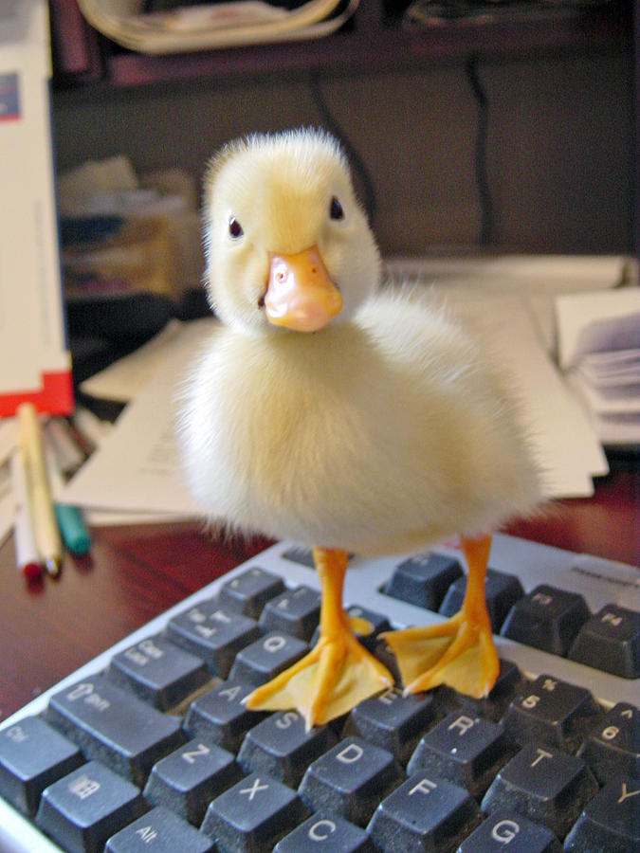
HINTS AND TRICKS!
Notes:
Add a delay to the start of scripts
Encode payloads / large lines of text in base 64
Don’t over think it

Slide 19
Disclaimer
Using this device, no matter how harmless the intention, without permission is illegal. We will be teaching you how to make your own bad USB, do not use this for malicious purposes, and do not use this outside of a lab environment.
Hacksoc is not responsible for anything you do using this technique

Slide 20

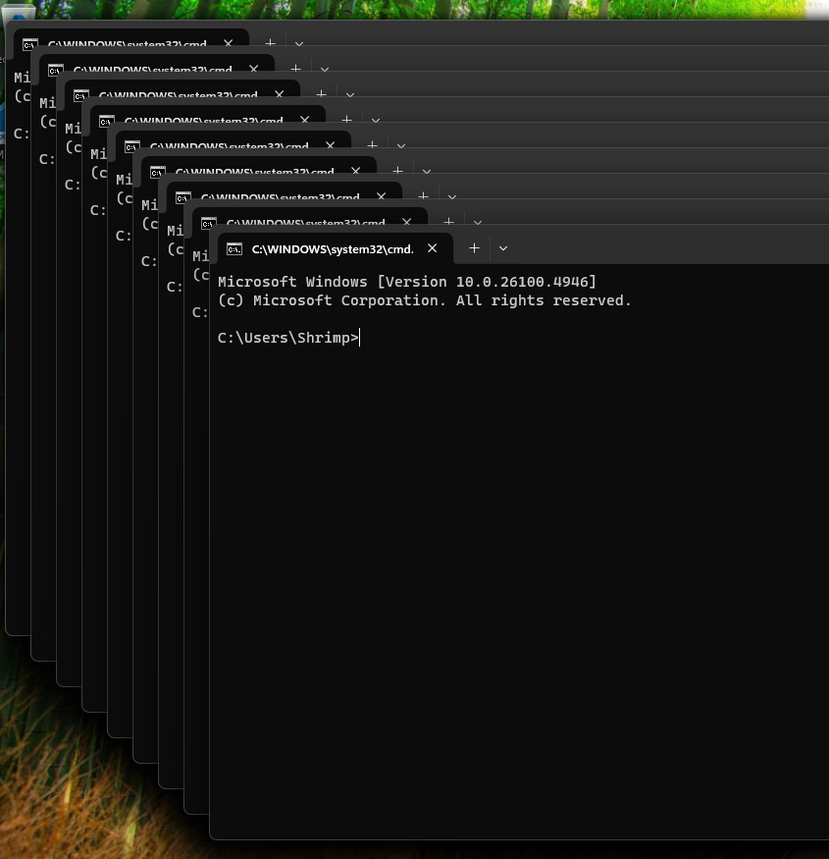
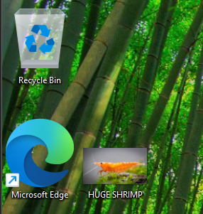
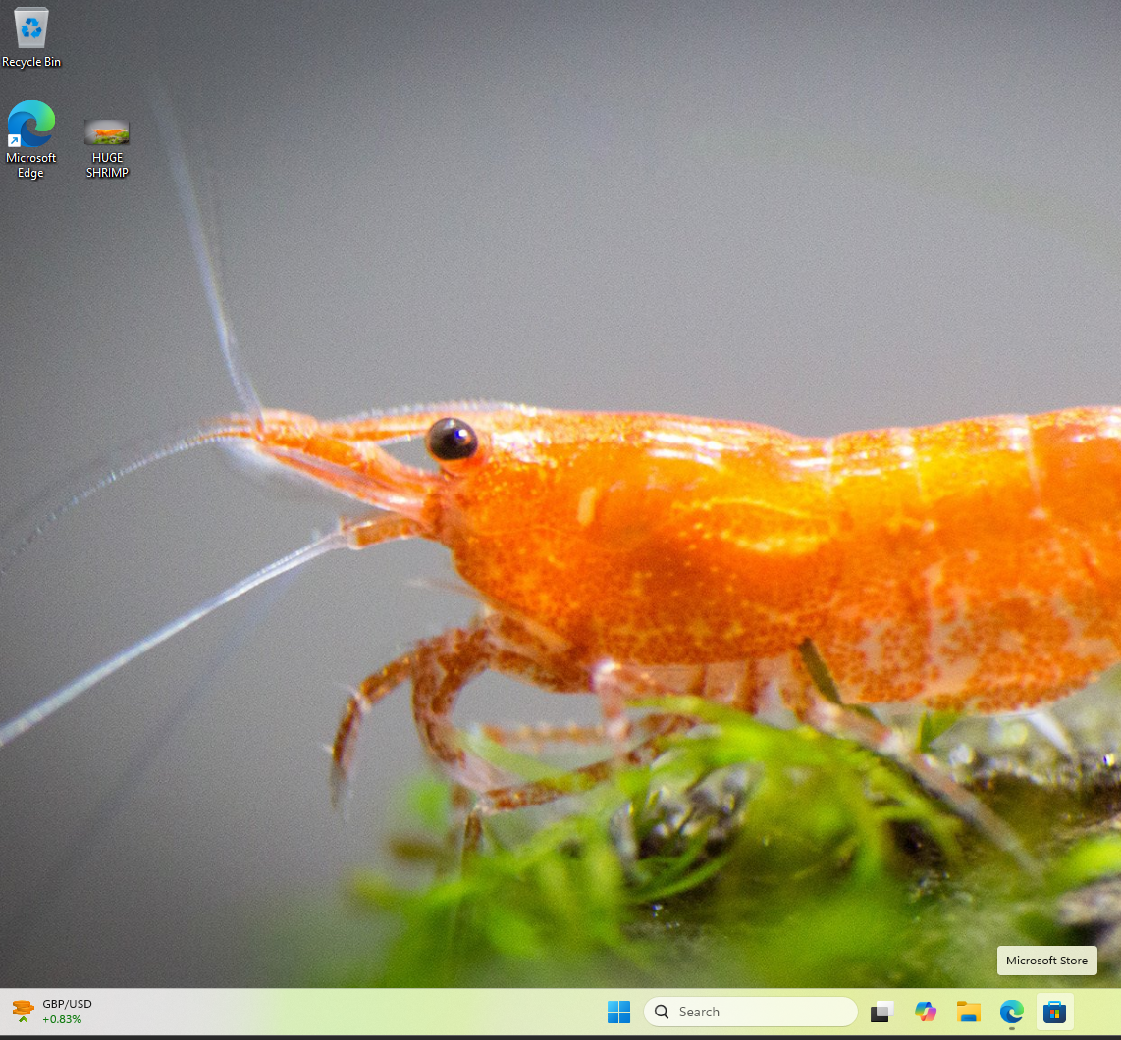

Hit List
If you want to (no pressure) you can attempt one of these tasks!
Whichever team completes a task the fastest will win a prize!
The Classic
Make a Rick Roll Script
The Spammer
Make lots and lots of windows
The Magician
Make an image appear on the desktop
The Super Magician
Make an image appear as the desktop
The Saboteur
Make the machine turn off

Slide 21
Over to you!
Have fun!

